Slide 1

IMPLEMENTING
GOVERNMENT-WIDE ENTERPRISE GIS;
THE FEDERATED MODEL
James E. Mitchell, Ph. D. IT GIS Manager Louisiana Department of Transportation and Development presented at the ESRI International Users Conference 2010
Notes:
Presented at the 2010 ESRI International Users Conference, Thursday July 15, 2010, San Diego, CA. Contact Information- Email: jim.mitchell@la.gov; Phone: 225/379-1881; Address: LADOTD Computer Center, 1201 Capitol Access Rd, Baton Rouge, LA 70802-4438

Slide 2
ENTERPRISE GIS USER MODEL
 |  |  |  | Level 0
 |  |  |  | Level 1
 |  |  |  | Level 2
 |  |  |  | Level 3
 |  |  |  | IT-GIS
 |  |  | IT Infrastructure
Taken from Mitchell and Kent, 2007
Notes:
The “Enterprise GIS User Model” first presented by Mitchell and Kent at the 2007 ESRI International users Conference, “Deploying Enterprise GIS in a State Agency” (copies available upon request). This model describes the types and levels of users who consume GIS data and services. This model provides the foundation for developing and providing GIS data and applications to a broad range of users.

Slide 3
Level 0 – Non-GIS Users
Description | Technology
Non-user, lacking access to or knowledge of GIS. These users have immediate information needs that only GIS can provide. | “Canned” GIS services must be provided to these users, for example, a map, report, data, or table. Basic training of these users can advance them to Level 1 Users.
Notes:
Enterprise GIS User Model – Level-0 Users. This cohort of users includes the least sophisticated users. Many do not know of GIS, but require data that come from a map. They may not have access to any GIS technology, so are best served through server-based methods.

Slide 4
Level 1 – Occasional Users
Description | Technology
Professionals with work that occasionally requires information provided only by GIS. | Thin client, web services and server applications that perform specific, well-defined, repetitive tasks. Thick-clients can be used with basic GIS training.
Notes:
Enterprise GIS User Model – Level-1 Users. This cohort of users includes those with limited access and little experience using GIS. They know that they require data from a map and may know that GIS technology can be used to get it. However, they have little knowledge of how to use GIS. These users’ data needs are best accommodated through server-based methods. However, training can allow these users to take advantage of GIS software to perform basic data query and map creation tasks.

Slide 5
Level 2 – Regular GIS Users
Description | Technology
Professionals with work that regularly calls for information provided only by GIS. These users need training in the use of GIS software to make maps, but, seldom use sophisticated analytical GIS features. | Thick-client applications, as well as, thin-client web and GIS server applications.
Notes:
Enterprise GIS User Model – Level-2 Users. This cohort of users regularly access GIS technology in the performance of their work. They know enough about how to use GIS technology to regularly perform data query and map production. They most likely started as Level-1 users who require additional spatial analysis and ad hoc capabilities that are not available through server-based GIS technology and received additional GIS training to do their work.

Slide 6
Level 3 – Advanced GIS Users
Description | Technology
Professionals that who regularly perform spatial analysis and/or produce GIS data, as part of their job. These are “power-users” with advanced training in GIS, including developing programs to do advanced mapping or other tasks. | Thick client applications that run locally on the desktop and provide advanced, sophisticated GIS functionality.
Notes:
Enterprise GIS User Model – Level-3 Users. This cohort of users is often called, “super-users” and regularly performance advanced spatial and other GIS analyses as a function of their job. They have moved up from lower-level user levels by receiving additional GIS training. Although these users can take advantage of server-based technology, their work requires advanced spatial analysis and ad hoc capabilities, including programming, data management, and other advanced IT skills.

Slide 7
IT-GIS
Description | Technology
Professionals possessing advanced experience; and IT skills, knowledge of geographic concepts of mapping and cartography. They have experience applying GIS within the context of a relevant professional discipline. | All levels and forms of GIS technology, in order to develop and maintain the GIS environment for the agency. This includes all aspects of training, tech support, application programming, and web development.
Notes:
Enterprise GIS User Model – IT GIS Staff. This is a small group of IT professionals competent in GIS technology, advanced spatial analysis and, other GIS skills. In addition, IT skills including database design and management, programming, web development, and other skills necessary to support an enterprise GI S system. This is the primary function of their job, which includes technical support, project development, data management, and training; all related to the agency’s GIS. These professionals require a broad range of skills and experience at an advanced level. These are not, "entry-level,” positions.

Slide 8
ENTERPRISE GIS USER MODEL in review
 |  |  |  | Level 0
 |  |  |  | Level 1
 |  |  |  | Level 2
 |  |  |  | Level 3
 |  |  |  | IT-GIS
 |  |  | IT Infrastructure
Notes:
A review of the Enterprise GIS User Model – See Slide #2 for details.

Slide 9
Important Features of the
User Model
Information can be delivered to the entire continuum of users across the enterprise, as well as outside the agency.
Training and experience will advance users up the continuum.
The entire user-base is supported by a small professional, IT-GIS staff that is integrated into the enterprise IT infrastructure.
Users at any level can benefit by the technology applied to serve lower user classes.
The IT-GIS staff is part of, and supported by, the agency’s existing IT infrastructure.
Notes:
The characteristics of agency-level enterprise GIS not only provide the framework for implementing and developing a local GIS program, it also provides the necessary elements to build on GIS services at a statewide level of government organization. In fact, it provides the mechanisms for cross government (local, state, federal) interaction and interoperability.

Slide 10









GIS CLIENT
IT PROFESSIONAL
GIS PROFEESIONAL
GIS USER
ENTERPRISE IT
ENTERPRISE IT
SERVICES
APPLICATIONS
ENTERPRISE
FIREWALL
ENTERPRISE
DATA
WEB
-
CLIENT
DATA
INTRANET
WEB
-
CLIENT
GIS APPLICATIONS
GIS APPLICATIONS
THIN
-
CLIENT
THIN
-
CLIENT
GIS APPLICATIONS
GIS APPLICATIONS
GIS USER LEVEL
INTERNET
INTERNET
INTERNET
GIS SERVER
WWW SERVER
APP SERVER
GIS USER LEVEL
DESKTOP
OGC
GIS
OGC
ESRI, GEOMEDIA
WMS & WCS
GEOSPATIAL
MAPINFO
FIREWALL
GEOSPATIAL
DATA
DATA
THICK
-
CLIENT
THICK
-
CLIENT
-
GIS APPLICATIONS
OPEN
-
SOURCE
GIS APPLICATIONS
OPEN
-
SOURCE
GIS
GIS APPLICATIONS
GIS APPLICATIONS
CUSTOMER / CLIENT
‘
DMZ
’
AGENCY / ENTERPRISE
-
0: PUBLIC OFFICIAL, PROFESSIONAL, OR GENERAL PUBLIC WITHOUT GIS
SKILLS OR ACCESS, REQUIRING INFORMATION
-
1: PROFESSIONAL OCCASIONALLY REQUIRING INFORMATION; BEST SERVED
USING GIS VIA WEB / SERVER / APPLICATIONS
-
2: PROFESSIONAL REGULARLY USING DATA REQUIRING GIS; BEST SERVED
VIA DESKTOP CLIENT / APPLICATION SERVER
-
3: PROFESSIONAL PERFORMING GIS ANALYSIS OR PROGRAMMING, OFTEN CR
EATES GIS DATA; REQUIRES DESKTOP CLIENT
Notes:
Data delivery, services, and interoperability require an enterprise GIS architecture. In this figure, the user levels served by the system appear on each side, with external users on the left, internal users on the right. Level-0 users appear at the top and more experienced users toward the bottom.

Slide 11
The “AAAAA” Data Standard
 | Factor | Contribution to Data Quality
 | Accurate | The data adequately represents the state of the world in space and time. Locations have sufficient precision for their scale of use and data are current.
 | Authoritative | The source of the data provides sufficient quality control to ensure its quality.
 | Actionable | The data are well documented with metadata, require little further assessment or manipulation, and can be put to immediate use.
 | Accessible | The data are discoverable and available through direct download or Service Oriented Architecture (SOA). Data can be searched directly, selected, and accessed without intervention by its provider.
 | Affordable | The data can be accessed with little or no cost to the user.
Notes:
The “AAAAA” data quality standard describes the essential elements of data quality that must be attained when developing and maintaining an enterprise GIS database.

Slide 12
The Current Status of USGS Maps
(Upated January 2010)
Notes:
The current status of the USGS 7.5-minute Quadrangle Map Series, as of January 2010. The significance of this figure is that paper maps were used in the 1970s to create the data used in GIS. Although paper maps were updated, until around the year 2000, the GIS data taken from earlier versions of the maps were never updated. As a result, most “authoritative” data from the USGS are badly out of date. To further complicate the situation, current aerial imagery match neither the paper maps nor the digital data.

Slide 13
How Up to Date are Louisiana’s Maps?
100% of paper maps are 5 years or older
83% of paper maps are 10 years or older
69% of paper maps are 15 years or older
42% of paper maps are 20 years or older
26% of paper maps are 25 years or older
Digital map data have never been updated
and are older than the paper maps
(Updated January 2010)
Notes:
Statistics depicting how up to date the paper maps are from the USGS 7.5-minute Quadrangle Maps Series, as of January 2010.

Slide 14
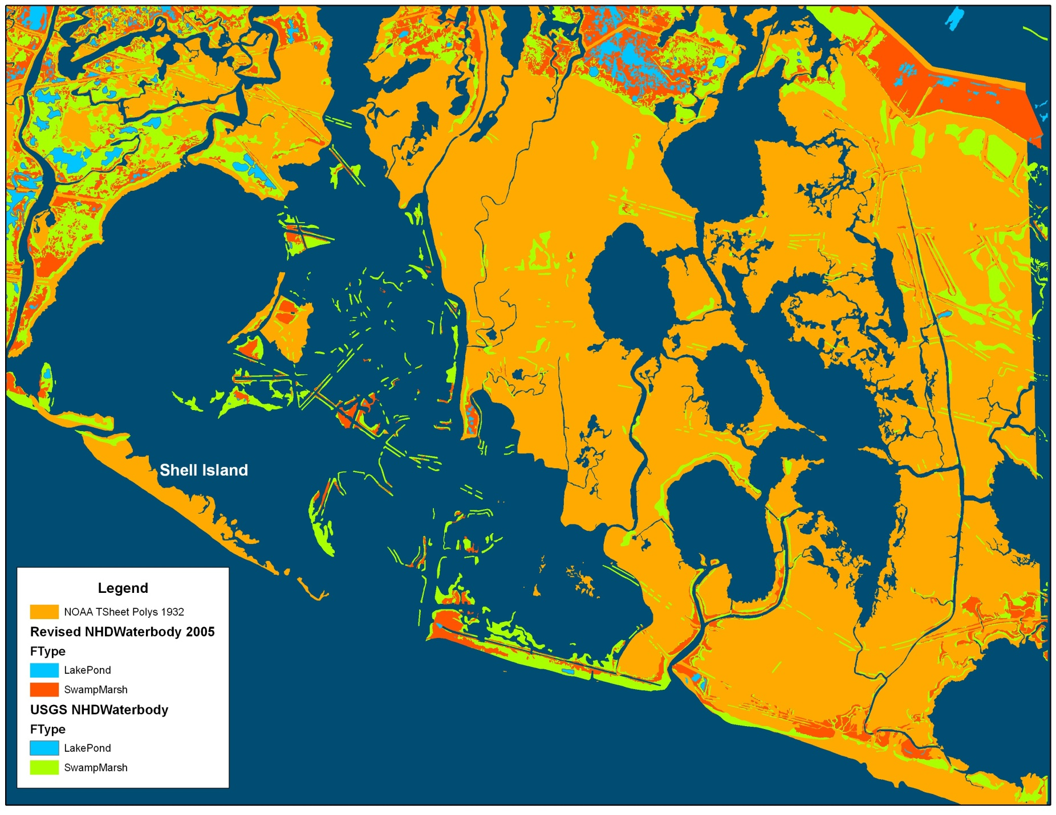
Where Has All the Coastline Gone?
Notes:
An example of coastal GIS data in Louisiana. In this figure, orange areas represent the coastline from the most current NOAA “T” sheets, collected in the 1930s. The green areas represent the most current coastline from the National Hydrography Dataset (NHD), taken from the most current USGS 7.5-minute Quadrangle Series. The red areas were taken from 2005, post Hurricanes Katrina and Rita digital orthoimagery. Today, the orange and green areas are open water.

Slide 15







LIFE CYCLE OF GOVERNMENT DATA
Data Collection
Data Management
Data Analysis
Decisions
Data
Distribution
State Government Agency
IT Infrastructure
Enterprise Databases
Business Units
Governor &
Legislature
State Mandated
Data
Office of the Secretary
Other State Agencies
Business Units
Operational/Business
Date
Management & Finance
General Public
The World
Federally Mandated
Data
Engineering
Notes:
State Government collects data for three reasons: 1.) It is mandated by the state Legislature or Governor, 2.) It is necessary to carryout its mission, or 3.) It is mandated by the federal government. The data are managed using the protocols dictated by the disciplines represented within the agency (agriculture, health, engineering, etc.). Likewise, access to and distribution of the data is also governed by the standards and professional practices represented within each agency. The release and distribution of the data are typically governed by open records laws.

Slide 16
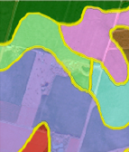
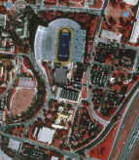
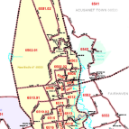






How Do We Build And Distribute The Base Map?
By Moving Data From Local Sources to the Enterprise Base Map
Commercial Data Producers
Desktop GIS Users
State Government
Local Data Producers
Hardcopy Maps, Web Maps,
and Data Analysis
Web Services for Easy, Transparent Access
Local Government
DOTD
Base Map Database
Louisiana Geographic Bureau
Federal
Government
On-Demand, Up to Date Printed Maps
One Base Map Providing Universal Access to All
General Public
Collaboration Between Local and State Government
Services (routing, geocoding, and Location-Based Services)
Map for non-GIS Users in Georeferenced PDF Format
Commercial Businesses
Data Collation, Quality Control, and Distribution
Data Services – Direct Access to the LA Base Map Data
Etc.
Providing Actionable Information to All Data Users
Notes:
The federated government-wide enterprise GIS is constructed through the collaborative efforts of all elements of state government. Each entity provides the mission-driven data they collect. This helps to maintain the data quality and streamline its delivery to decision makers. In contrast, the digital base map must be the responsibility of one or more state agencies.

Slide 17
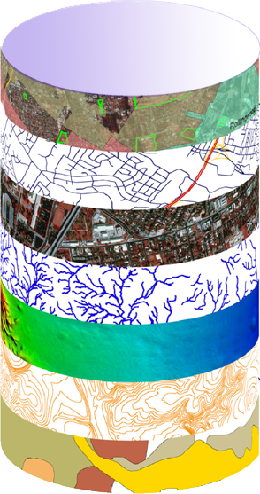
Statewide Enterprise Digital Map Base
Accurate, Authoritative, Actionable , Accessible , and Affordable Information
ESSENTIAL
FUNCTIONS OF
GOVERNMENT
DOTD
Base Map
FRAMEWORK DATA
Transportation
and
Infrastructure
Topography
Hydrography
Transportation
Agriculture
Natural Resources
Environmental Quality
Boundaries
Land Cover / Land Use
Manmade Structures
Public Safety
And
Homeland Security
Public Land Survey
Education
Health
Human Services
Streamlining – Shortening the Distance Between Data Collection and Decision Makers
Notes:
The framework data that comprise the digital map base are used by many different government functions. As such, it constitutes the foundation of all geospatial interoperability across all agencies and levels of government. The government-wide enterprise GIS requires a “AAAAA” base map.

Slide 18
How Are The Statewide Enterprise Digital Map Base Layers Used by State Government?
Transportation
and
Infrastructure
Agriculture
Natural Resources
Environmental Quality
Public Safety
And
Homeland Security
Education
Health
Human Services
Construction
Economic Development
Access to Highways
Access to Rail
Access to Ports
Access to Air
Emergency Response
Emergency Recovery
Flood Control
Location of:
Clients
Facilities & Services
Vendors
Mapping
Operations
Permits
Establishing
Managing
Enforcement
Planning
Ports & Waterways
Railroads
Roads
School Attendance
Transit
Public Relations/Information
Safety
Finding Travel Route from Point to Point
311
Access to Markets
Economic Development
Emergency Response
Emergency Recovery
Environmental Assessment
Impacts
Mitigation
Location of:
Clients
Facilities & Services
Vendors
Mapping
Operations
Permits
Establishing
Managing
Enforcement
Planning
Public Relations/Information
Safety
Finding Travel Route from Point to Point
Emergency Response
Emergency Recovery
Location of:
Clients
Facilities & Services
Vendors
Mapping
Operations
Permits
Establishing
Managing
Enforcement
Planning
Hazard Mitigation
Risk Assessment
Roads
Public Relations/Information
Safety
Finding Travel Route from Point to Point
911
Emergency Response
Emergency Recovery
Fraud Detection
Location of:
Clients
Facilities & Services
Vendors
Mapping
Operations
Permits
Establishing
Managing
Enforcement
Planning
Placement of Facilities
Risk Assessment
Roads
Public Relations/Information
Public Right to Know
Safety
Finding Travel Route from Point to Point
Streamlining – Creating a Common Operating Environment
Where Agencies Can Cooperate and Interact
Notes:
The framework layers perform a myriad of different functions. Each agony has its own unique ways of using the framework data and combining the mission-driven data that they collect. With a single base map, all agencies are on the same map and their data will properly interact. This “one map” approach provides coincidence in location and topology and promotes interoperability across the government-wide enterprise GIS.

Slide 19
Government-wide Federated Enterprise GIS in Action – Hurricane Response Case Study
Hurricane Gustav Advisory #28
Forecast Winds
Forecast Wind Speed
Blue = Tropical Storm, > 39 mph
Yellow = Gale, 58 – 74 mph
Red = Hurricane, > 74 mph
Notes:
Emergency operations provide an excellent opportunity to examine the strengths of the Federated GIS Model. Hurricane Advisories are issued every six hours by the National Hurricane Center. Each Advisory provides storm location, forecast path, and forecast wind paths, among other spatial information. These data can be obtained from the NOAA-NHC server and put in the enterprise database. Once availed locally, it can be served to other members of the government-wide enterprise GIS or the public, at large. This slide shows Hurricane Gustav Advisory #28. At the time of this Advisory, it is clear that most of the state will be impacted by tropical storm-force winds. Using GIS technology, all critical infrastructure facilities can be evaluated for their probable risk.

Slide 20







Using The Base Map for Emergency Response
A Federation of Agency-level Enterprise GIS
NOAA Real-time Weather Data
Local Data Updates
DOTD
Secretary
DOTD
EOC
Operations
Staff
Agency-wide
Situational Awareness
Using
Business Intelligence and
Dashboard Applications
DOTD Enterprise GIS
ArcGIS Server Web Services
DOTD
Enterprise
Base Map
Database
Service Oriented Architecture
State House and Senate Members
Cached Base Map
Real-time Dynamic Data Services
Geoprocessing Services
What Hospitals are in the path of the storm and which are open?,?
Where Can We Send Evacuating Medical Special Needs?
What Chemical Plants are in the Path of the Storm?
Which Rigs and Wells are in the Path of the Storm?
Real-time
Status
Reports
Database Query
DHH Hospital Status (EMSTAT) Database
LSU Medical Special Needs Operations
DEQ Chemical Plants (Tempo) Database
DNR Oil and Gas Well (SONRIS) Database
Authoritative Response
Notes:
During emergency operations, data can be ingested from authoritative source(s). In this case, it is the NOAA-National Hurricane Center. Once on the DOTD server, it is immediately available to the entire enterprise. Within DOTD, the data are used for situational awareness and are provided through business intelligence (BI) and dashboard applications. These are available at all levels of the Department to support mission-driven, transportation responses. The data are also available to other agencies supporting their own missions. In this diagram, the Louisiana Department of Natural Resources (DNR), Department of Environmental Quality (DEQ), Department of health and Hospitals (DHH), and LSU Medical Special Needs all consume services and data from DOTD. These agencies fulfill their own roles in the emergency response plan. In this case, DHH is maintaining a database of hospital status (EMSTAT) that is updated every twelve hours by the hospitals. This, in-turn, can be made available to the LSU Medical Special Needs triage unit to find out where they can dispatch patients they receive from facilities closed by the on-coming storm. All of this happens in real-time within the agencies know how to handle their data.

